Slide 1
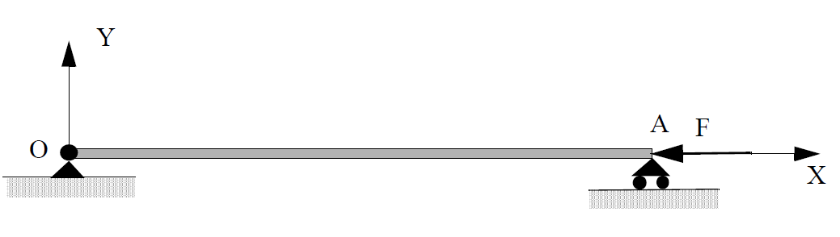
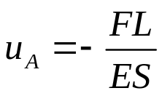
Buckling
Exact solution according to the elasticity
Several Loads - CAUC- 2011

Slide 2
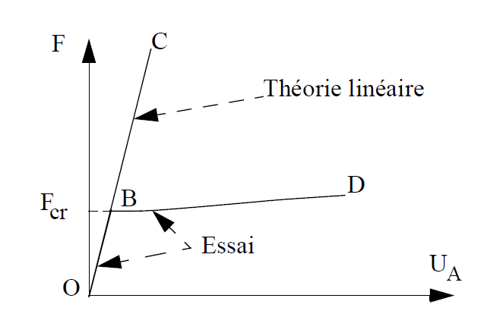
Buckling
Comparison Theory / Experimentation
Several Loads - CAUC- 2011

Slide 3
Buckling
Several Loads - CAUC- 2011

Slide 4
Methods to find the critical buckling load
Two methods :
The first consists in writing an equilibrium starting of an initial equilibrium with a small perturbation
The second consists in writing the minimization of the total energy
Several Loads - CAUC- 2011

Slide 5
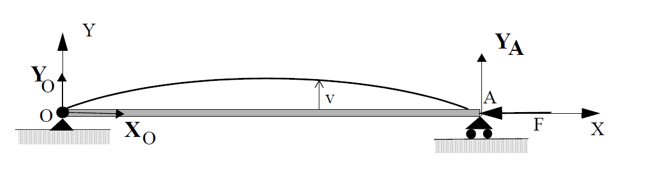
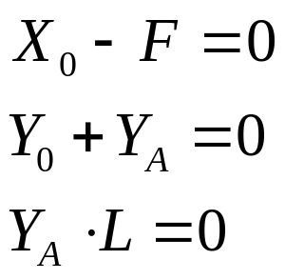

Method of Adjacent equilibrium
Equilibrium
Bending Moment
Several Loads - CAUC- 2011

Slide 6
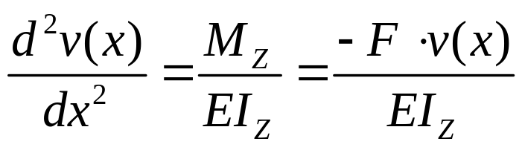
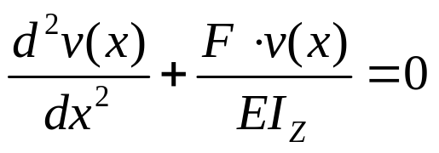
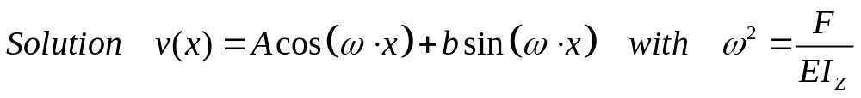
Method of Adjacent equilibrium
Deflexion of the Middle Line
Several Loads - CAUC- 2011

Slide 7
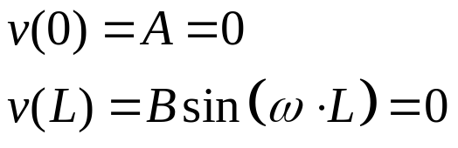
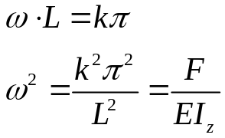
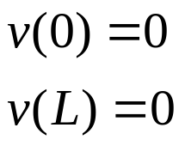
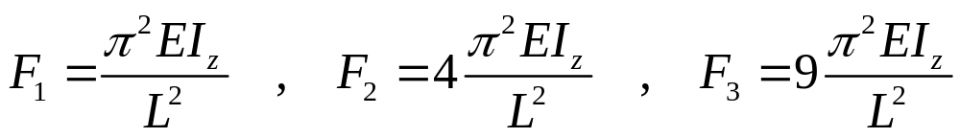
Method of Adjacent equilibrium
Boundary Conditions
Several Loads - CAUC- 2011

Slide 8
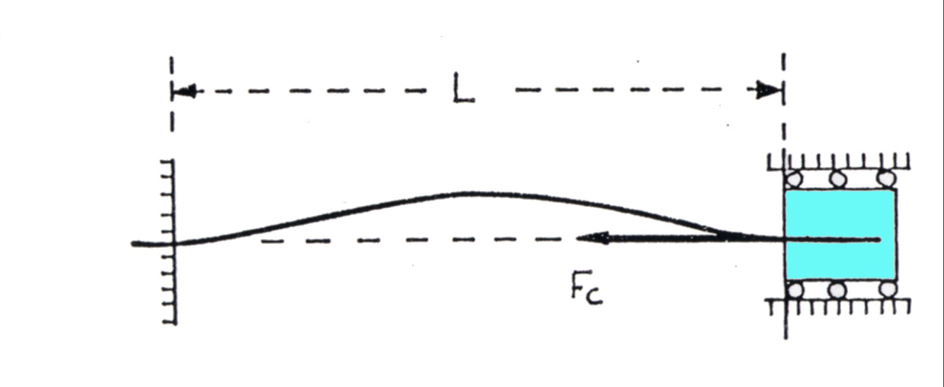
Method of Adjacent equilibrium : Exemple 1
Several Loads - CAUC- 2011

Slide 9
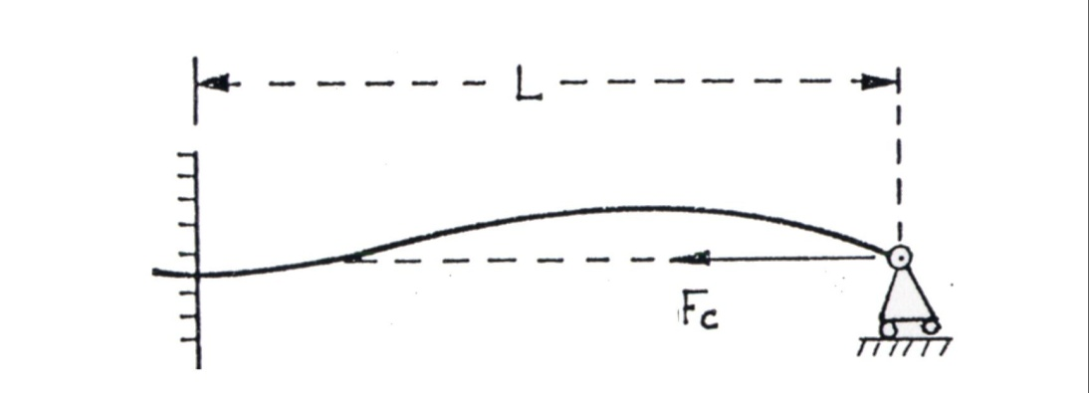
Method of Adjacent equilibrium : Exemple 2
Several Loads - CAUC- 2011

Slide 10
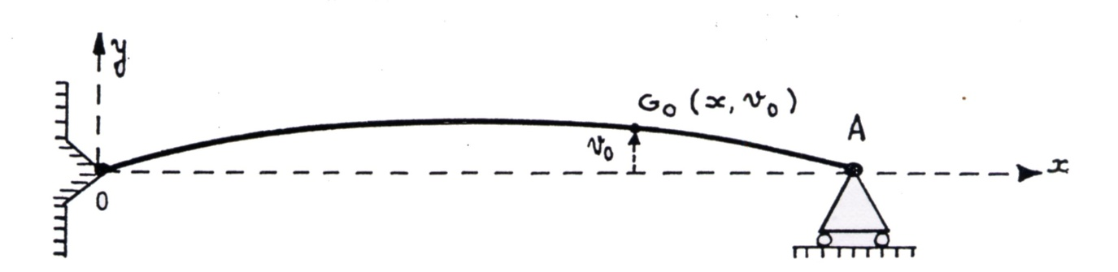
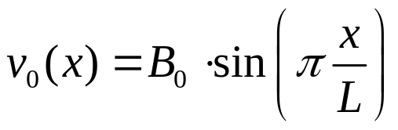
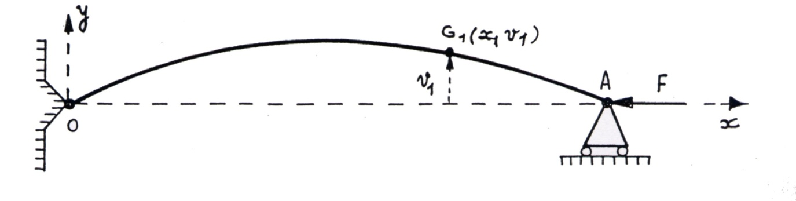
Influence of initial deflexion
Several Loads - CAUC- 2011

Slide 11
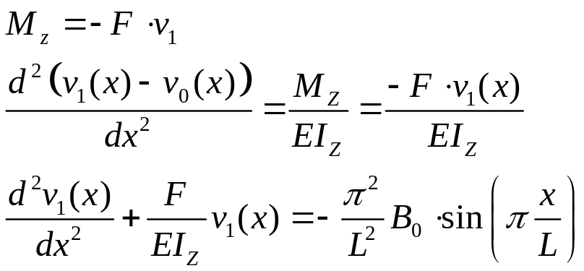
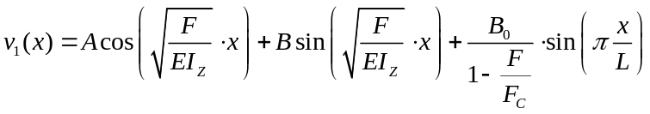
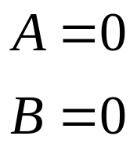
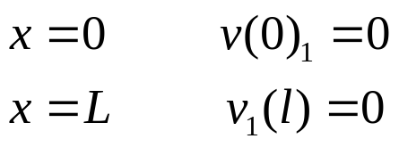
Influence of initial deflexion
Solution
Boundary conditions
Several Loads - CAUC- 2011

Slide 12
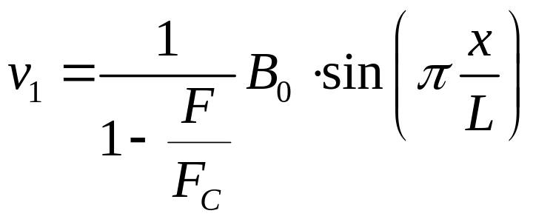
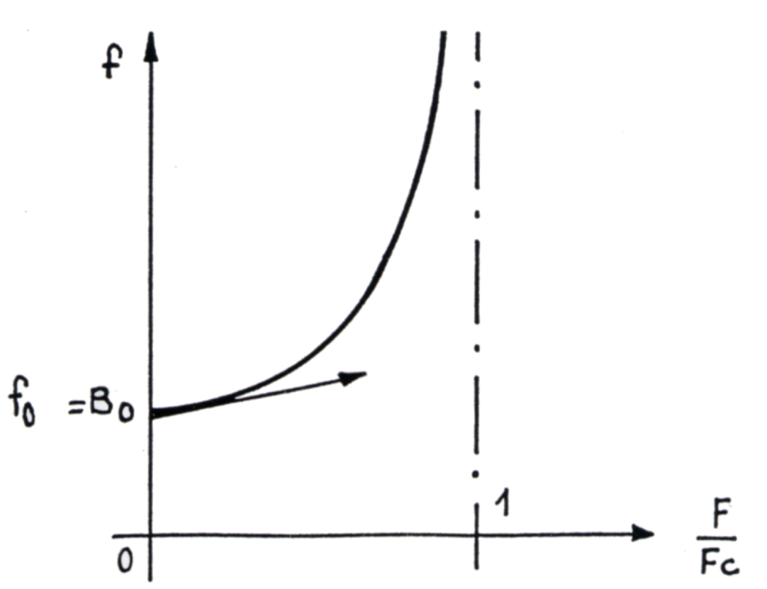
Influence of initial deflexion
Variation of the maximum deflexion (x=L/2) when the load applied ranges between 0 and Fc
Several Loads - CAUC- 2011

Slide 13
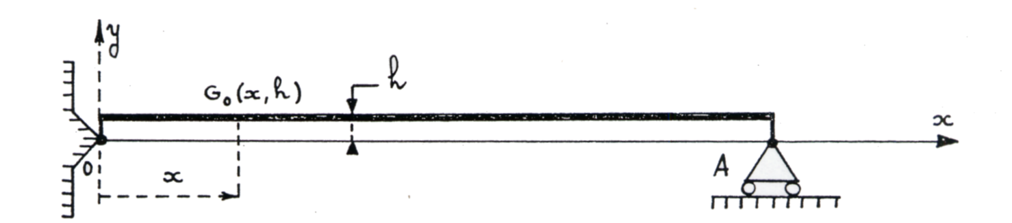
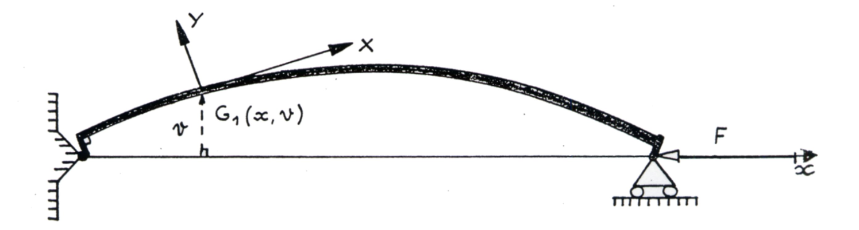
Influence of an initial offset of the load
Several Loads - CAUC- 2011

Slide 14
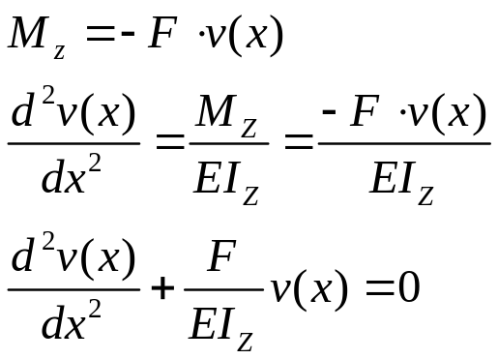
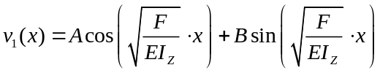
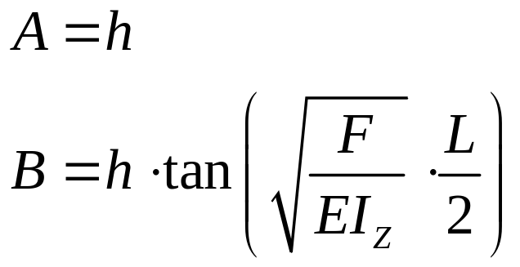
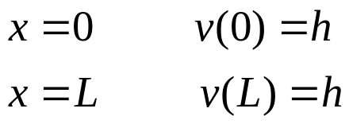
Influence of an initial offset of the load
Solution
Boundary conditions
Several Loads - CAUC- 2011

Slide 15
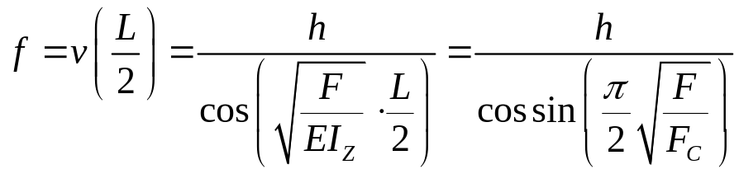
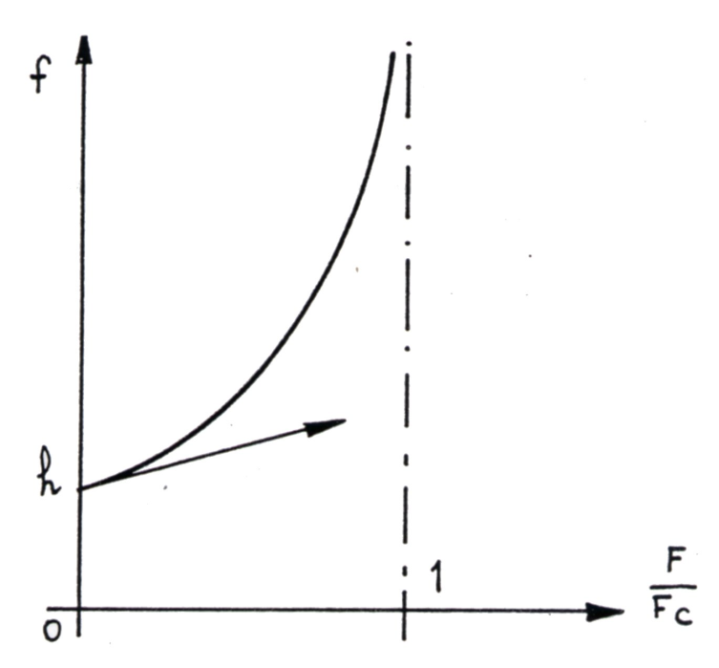
Influence of an initial offset of the load
Variation of the maximum deflexion when the load applied ranges between F = 0 and F = Fc
Several Loads - CAUC- 2011

Slide 16
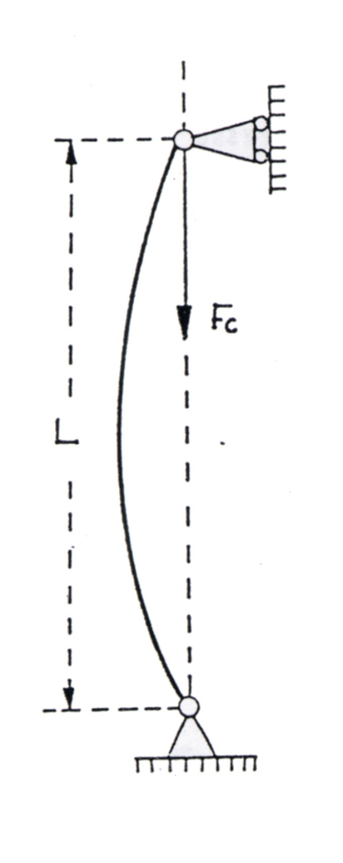
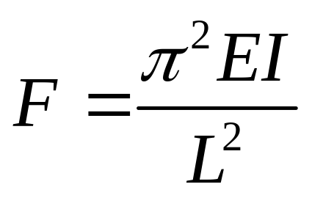
Form
Critical force for a bar in compression :
Several Loads - CAUC- 2011

Slide 17
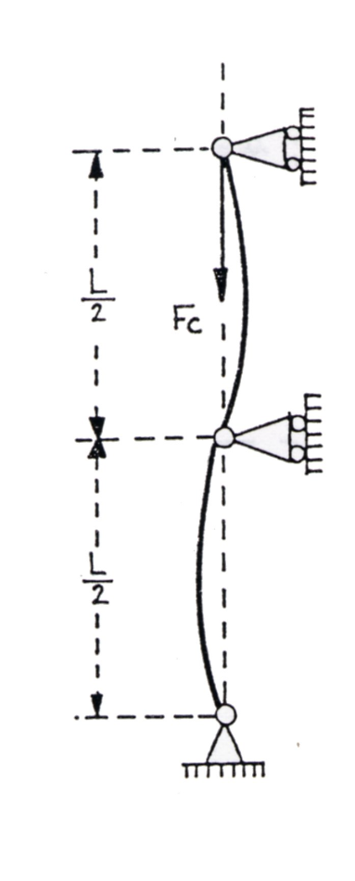
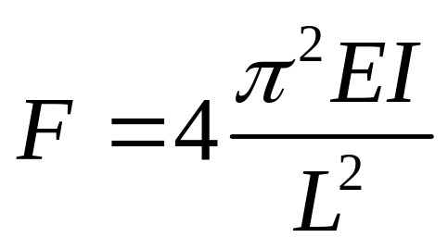
Form
Several Loads - CAUC- 2011

Slide 18
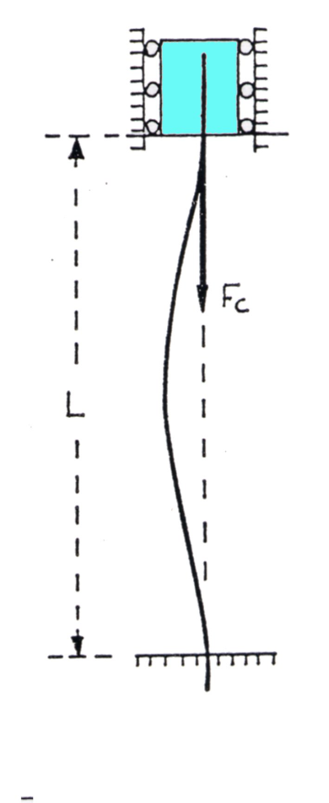
Form
Several Loads - CAUC- 2011

Slide 19
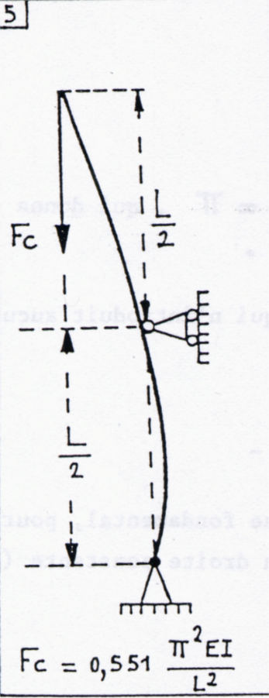
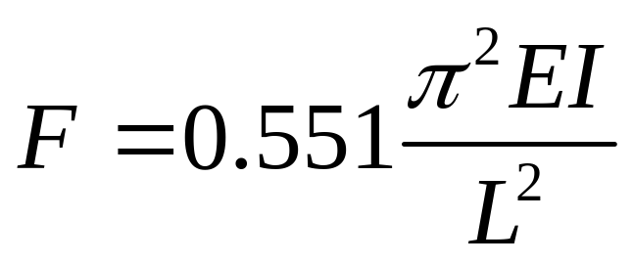
Form
Several Loads - CAUC- 2011

Slide 20
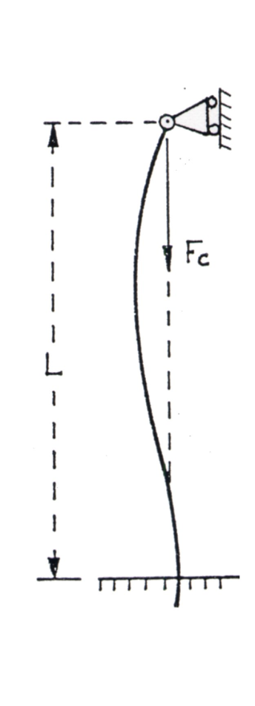
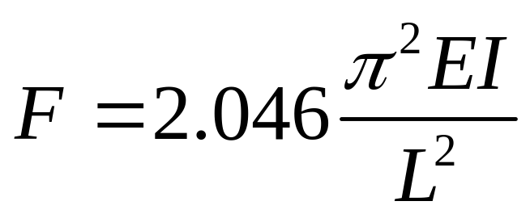
Form
Several Loads - CAUC- 2011

Slide 21
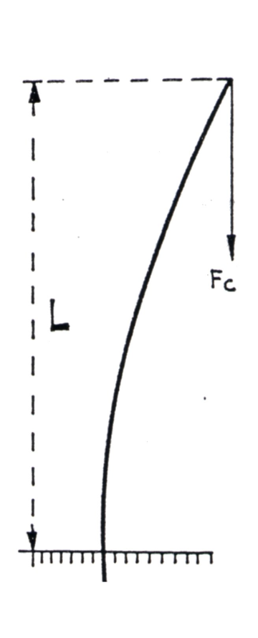
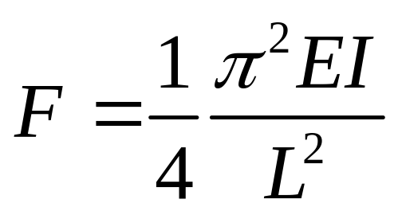
Form
Several Loads - CAUC- 2011

Slide 22
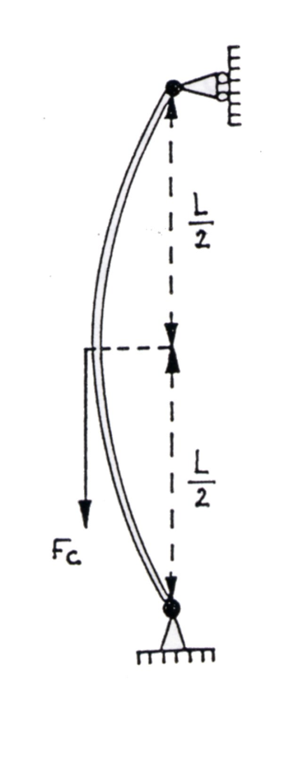
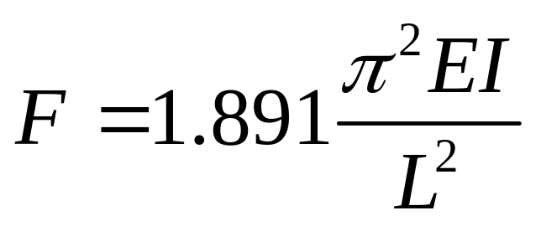
Form
Several Loads - CAUC- 2011

Slide 23
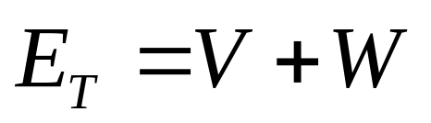
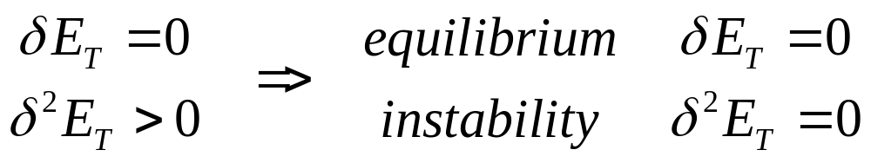
Method of Energy
Definition : We call total energy of a structure, the sum of :
- The external potential energy V
- The internal energy W
Lejeune-Dirichlet’s Theorem :
- When the total energy is minimum, the structure is in equilibrium.
Several Loads - CAUC- 2011

Slide 24
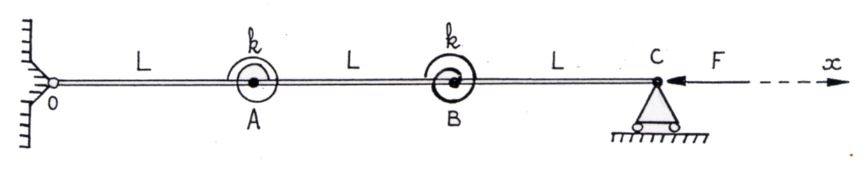
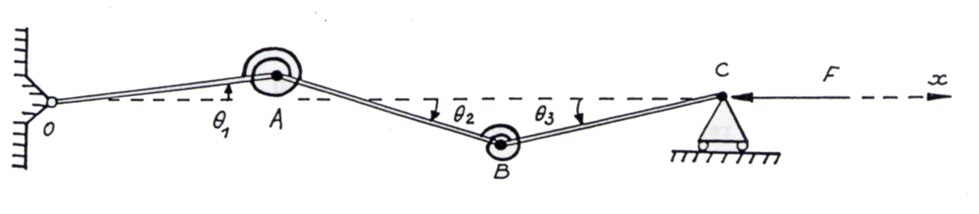
Method of Energy : exemple 1
Initial equilibrium
System with small perturbation
Several Loads - CAUC- 2011

Slide 25

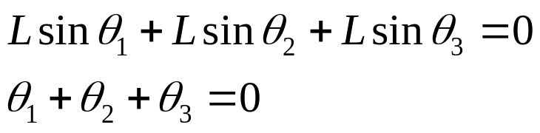
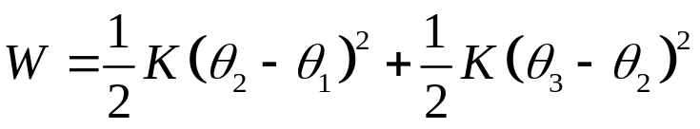
Method of Energy : exemple 1
Projection on Y axis
Internal Energy :
Potential Energy :
Several Loads - CAUC- 2011

Slide 26




Method of Energy : exemple 1
Internal Energy :
Potential Energy :
Total Energy
Several Loads - CAUC- 2011

Slide 27






Method of Energy : exemple 1
Total Energy
Several Loads - CAUC- 2011

Slide 28





Method of Energy : exemple 2
System with a small perturbation
Internal Energy
Several Loads - CAUC- 2011

Slide 29




Method of Energy : exemple 2
Potential Energy
=
- (Work of external Load)
Several Loads - CAUC- 2011

Slide 30



Method of Energy : exemple 2
Several Loads - CAUC- 2011

Slide 31
Method of Energy : exemple 2
Error = 20%
Several Loads - CAUC- 2011

Slide 32

Method of Energy : exemple 2
To decrease the error, we can choose another equation for the deflexion
Several Loads - CAUC- 2011

